Slide 1



MERN – ES6 + React
Module 11: ES6 - I

Slide 2
Outline
Module 11: ES6 - I
ES6 Basics
Understand concepts of Babel
Understand concepts of Let and const
Understand concepts of Creating variables
Understand concepts of Template and Strings
Understand concepts of Arrow Functions
Understand concepts of Rest and Spread Operators

Slide 3
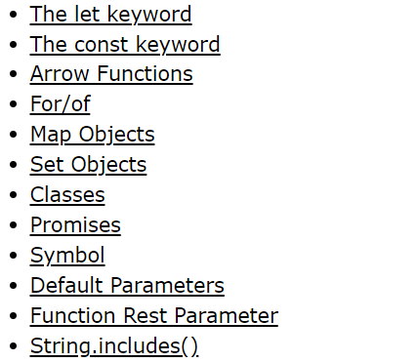
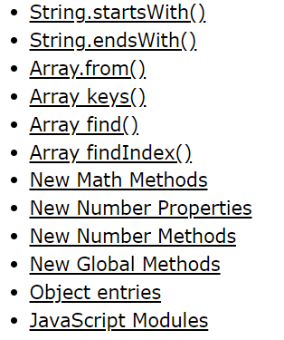
New Features in ES6
JavaScript ES6

Slide 4
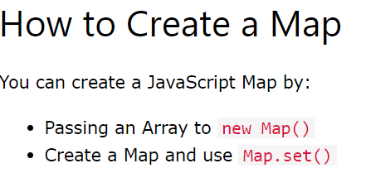
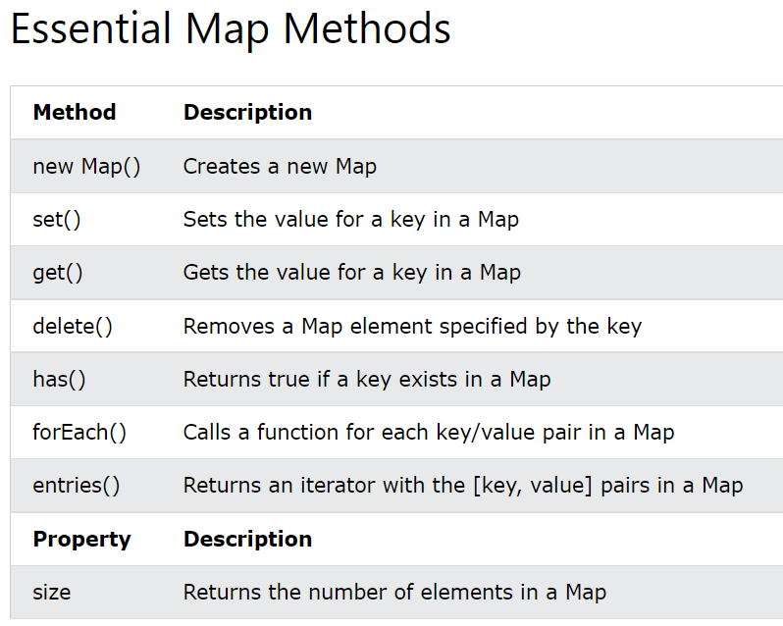
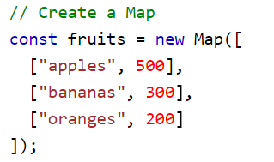
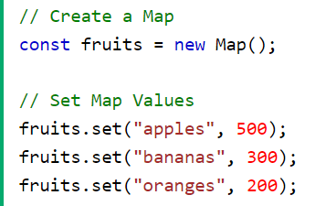
JavaScript Maps
A Map holds key-value pairs where the keys can be any datatype.
Tryit Editor v3.7 (w3schools.com)

Slide 5
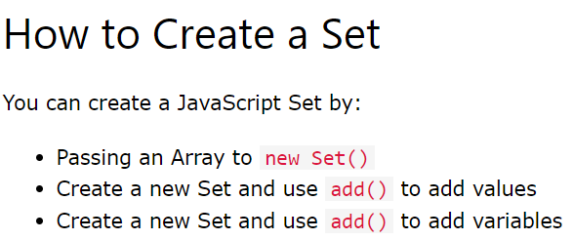
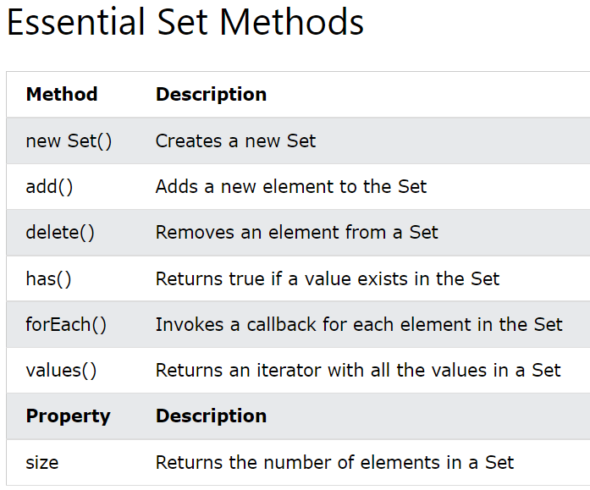

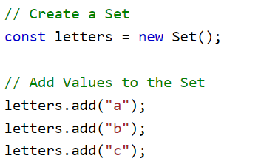
JavaScript Sets
A JavaScript Set is a collection of unique values.
Tryit Editor v3.7 (w3schools.com)

Slide 6
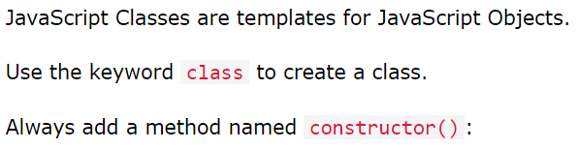
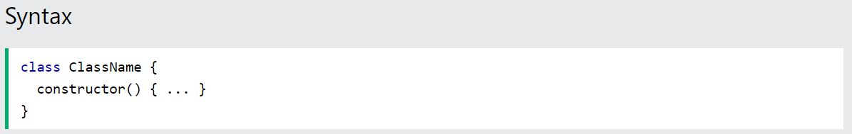
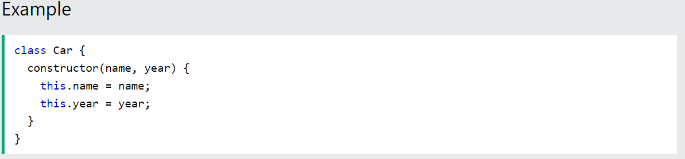

JavaScript Classes
JavaScript ES6

Slide 7
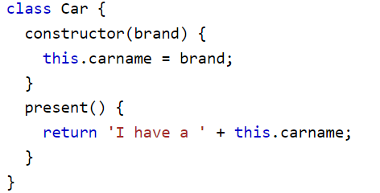
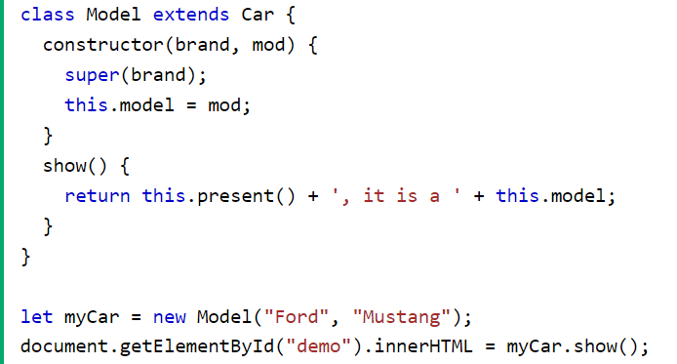
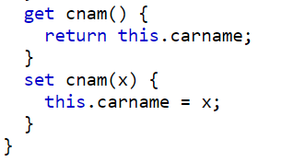
JavaScript Class Inheritance
JavaScript ES6

Slide 8
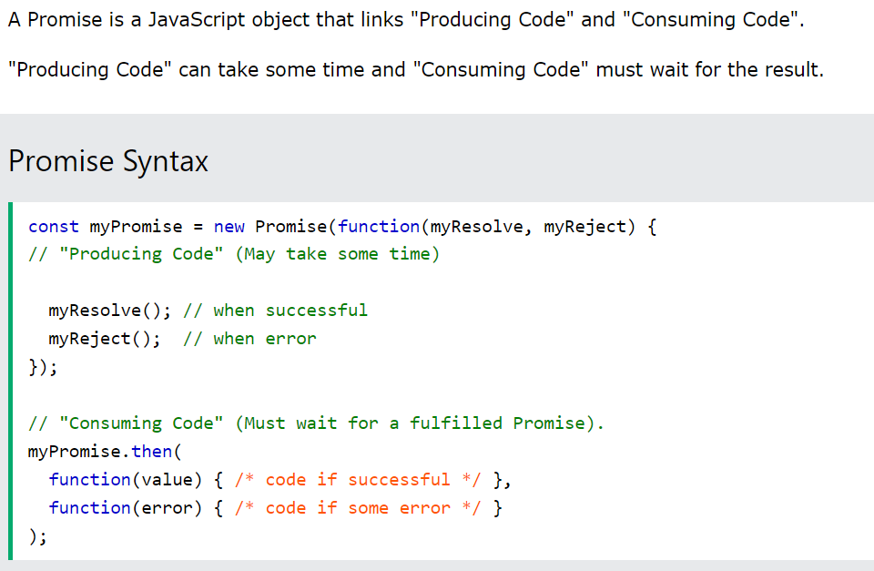
JavaScript Promises
JavaScript ES6
Tryit Editor v3.7 (w3schools.com)

Slide 9
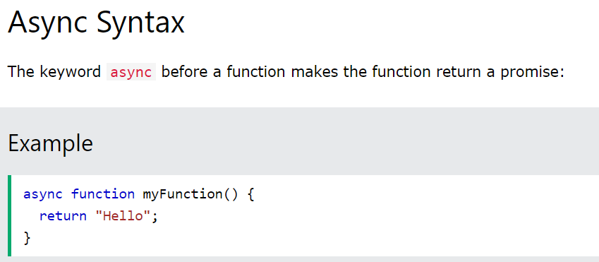
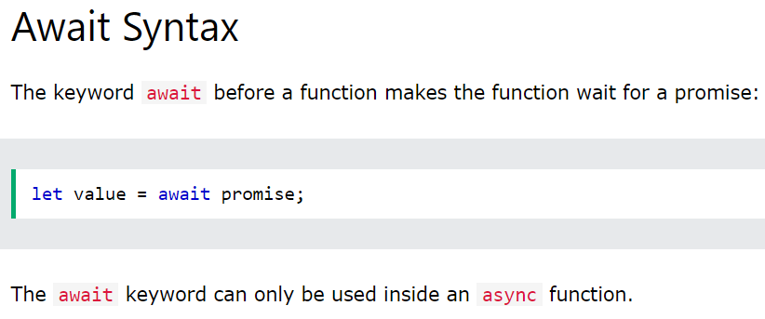
JavaScript Async
"async and await make promises easier to write"
Tryit Editor v3.7 (w3schools.com)

Slide 10
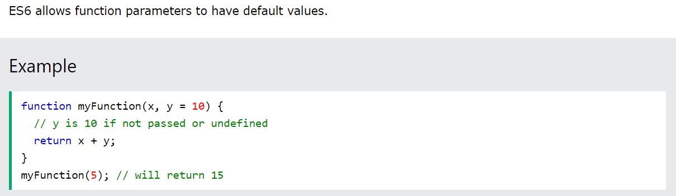
Default Parameter Values
JavaScript ES6

Slide 11
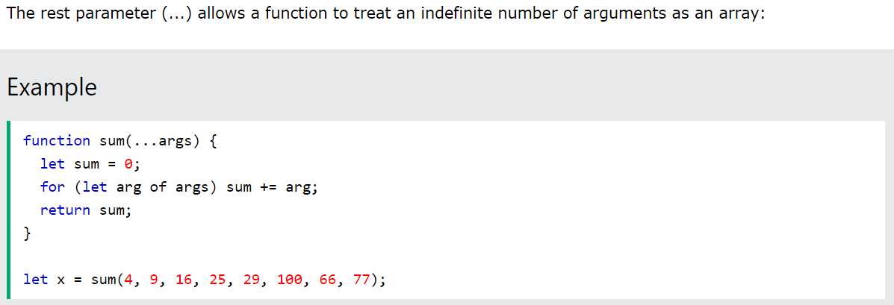
Function Rest Parameter
JavaScript ES6

Slide 12
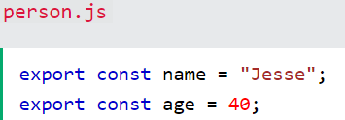
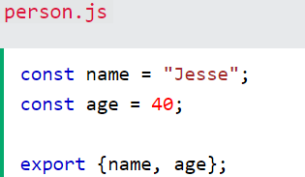
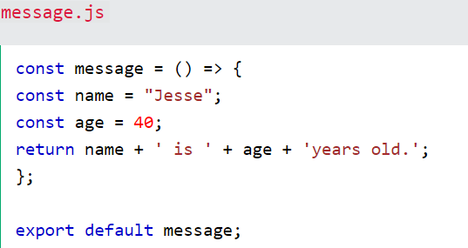
Modules
JavaScript modules allow you to break up your code into separate files.
JavaScript modules rely on the import and export statements.
Export
You can export a function or variable from any file.
There are two types of exports: Named and Default.
Named Exports
You can create named exports two ways. In-line individually, or all at once at the bottom.

Slide 13
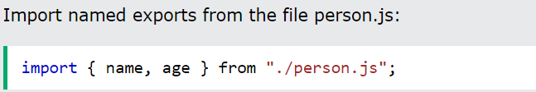
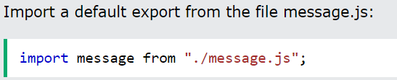
Modules
JavaScript modules allow you to break up your code into separate files.
JavaScript modules rely on the import and export statements.
Import
You can import modules into a file in two ways, based on if they are named exports or default exports.
Named exports are constructed using curly braces. Default exports are not.

Slide 14
JavaScript in DOM and BOM

Slide 15
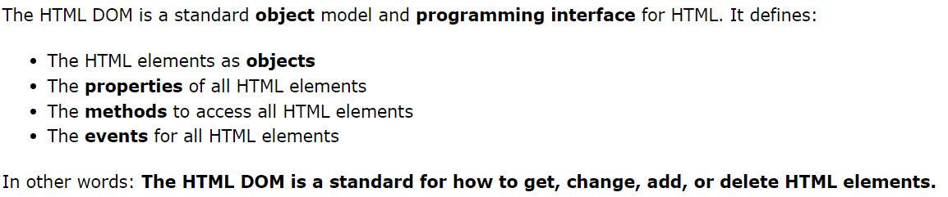
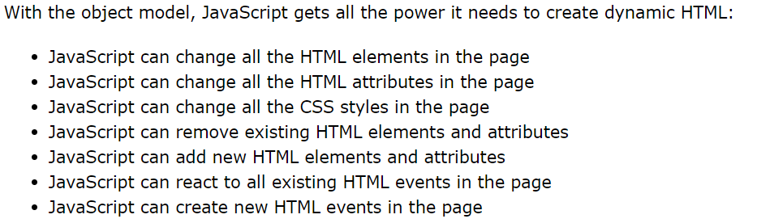

JavaScript HTML DOM
With the HTML DOM, JavaScript can access and change all the elements of an HTML document.

Slide 16
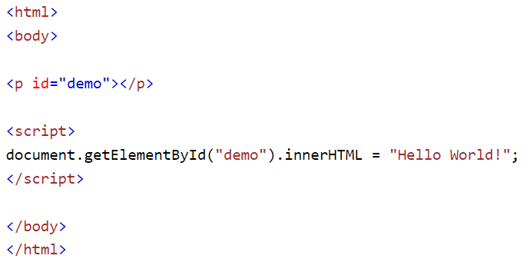
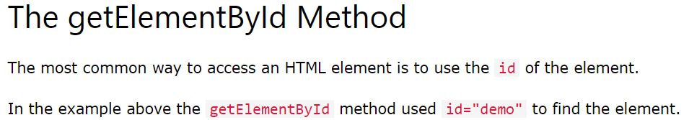
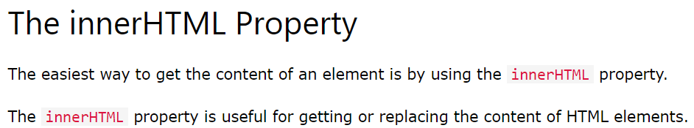
The DOM Programming Interface
JavaScript HTML DOM

Slide 17
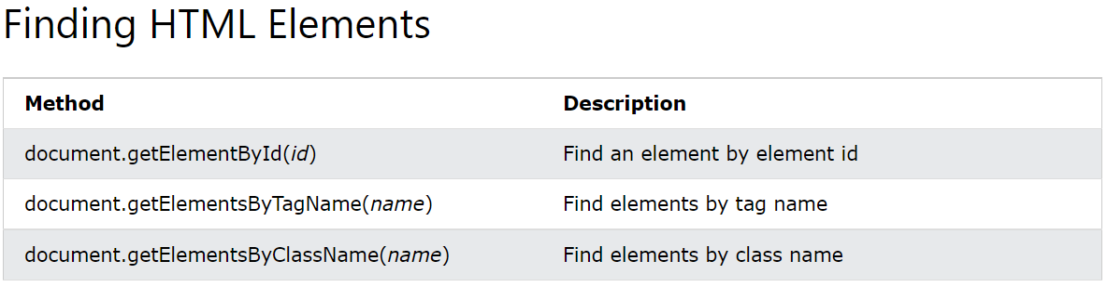
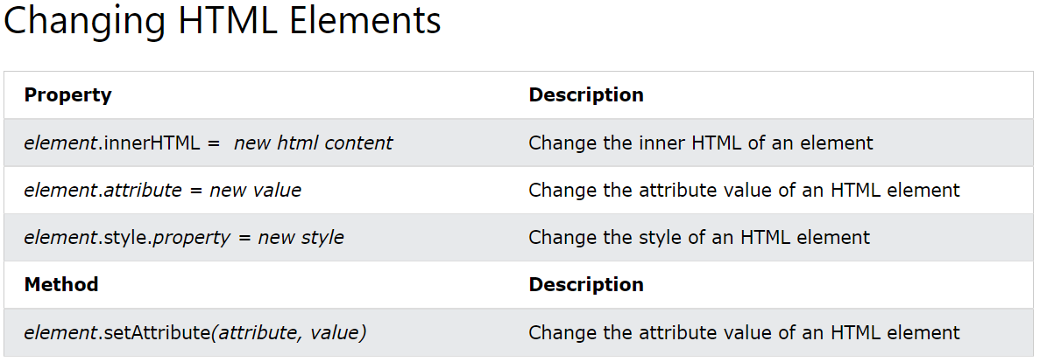
The DOM Programming Interface
The HTML DOM document object is the owner of all other objects in your web page.

Slide 18
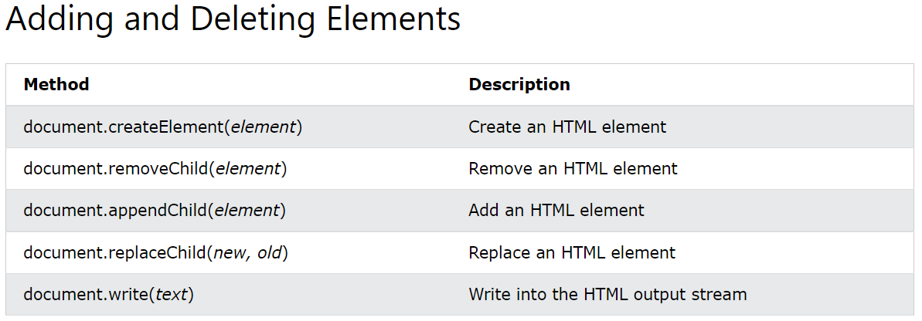
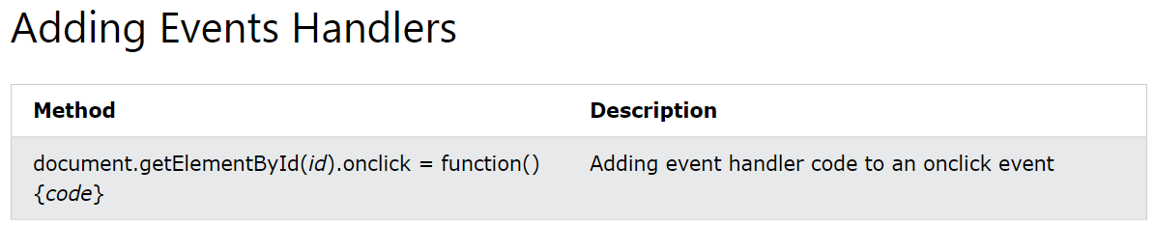
The DOM Programming Interface
The HTML DOM document object is the owner of all other objects in your web page.

Slide 19
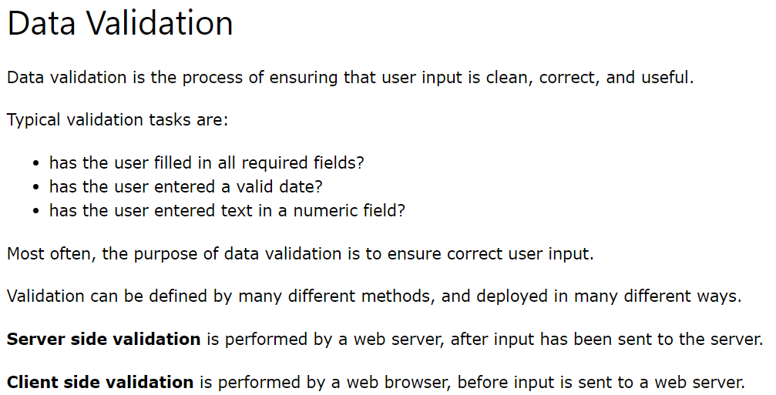
JavaScript Form Validation
JavaScript HTML DOM
Example 1
Example 2
Example 3

Slide 20
Changing HTML Style
JavaScript HTML DOM
Changing HTML Style
The HTML DOM allows JavaScript to change the style of HTML elements.
Example 1
Example 2
Example 3

Slide 21
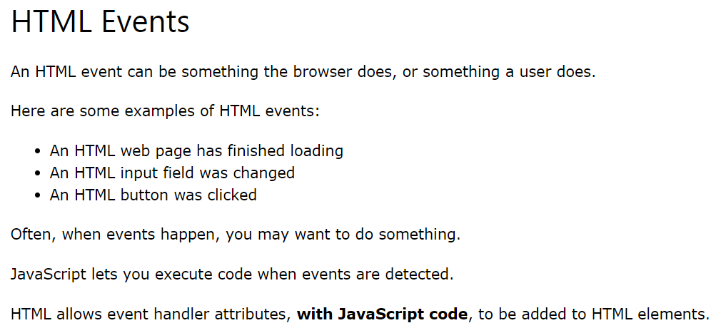
JavaScript Events
JavaScript basics
Example

Slide 22
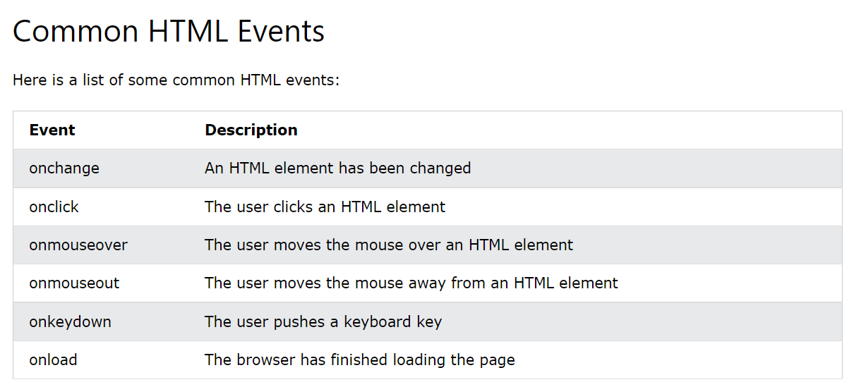
JavaScript Events
JavaScript basics
Example 1
Example 2
Example 3

Slide 23
Module 11: ES6 - I
Module 11
ES6 Basics
Understand concepts of Babel
Understand concepts of Let and const
Understand concepts of Creating variables
Understand concepts of Template and Strings
Understand concepts of Arrow Functions
Understand concepts of Rest and Spread Operators

